Slide 1
Project - 0:
Analysing a dataset using python libraries along with visualising data and implementing ML algorithms
Technologies USED:
Python (jupyter), Numpy, pandas, Scikit-learn, seaborn, machine learning (linear regression)

Slide 2
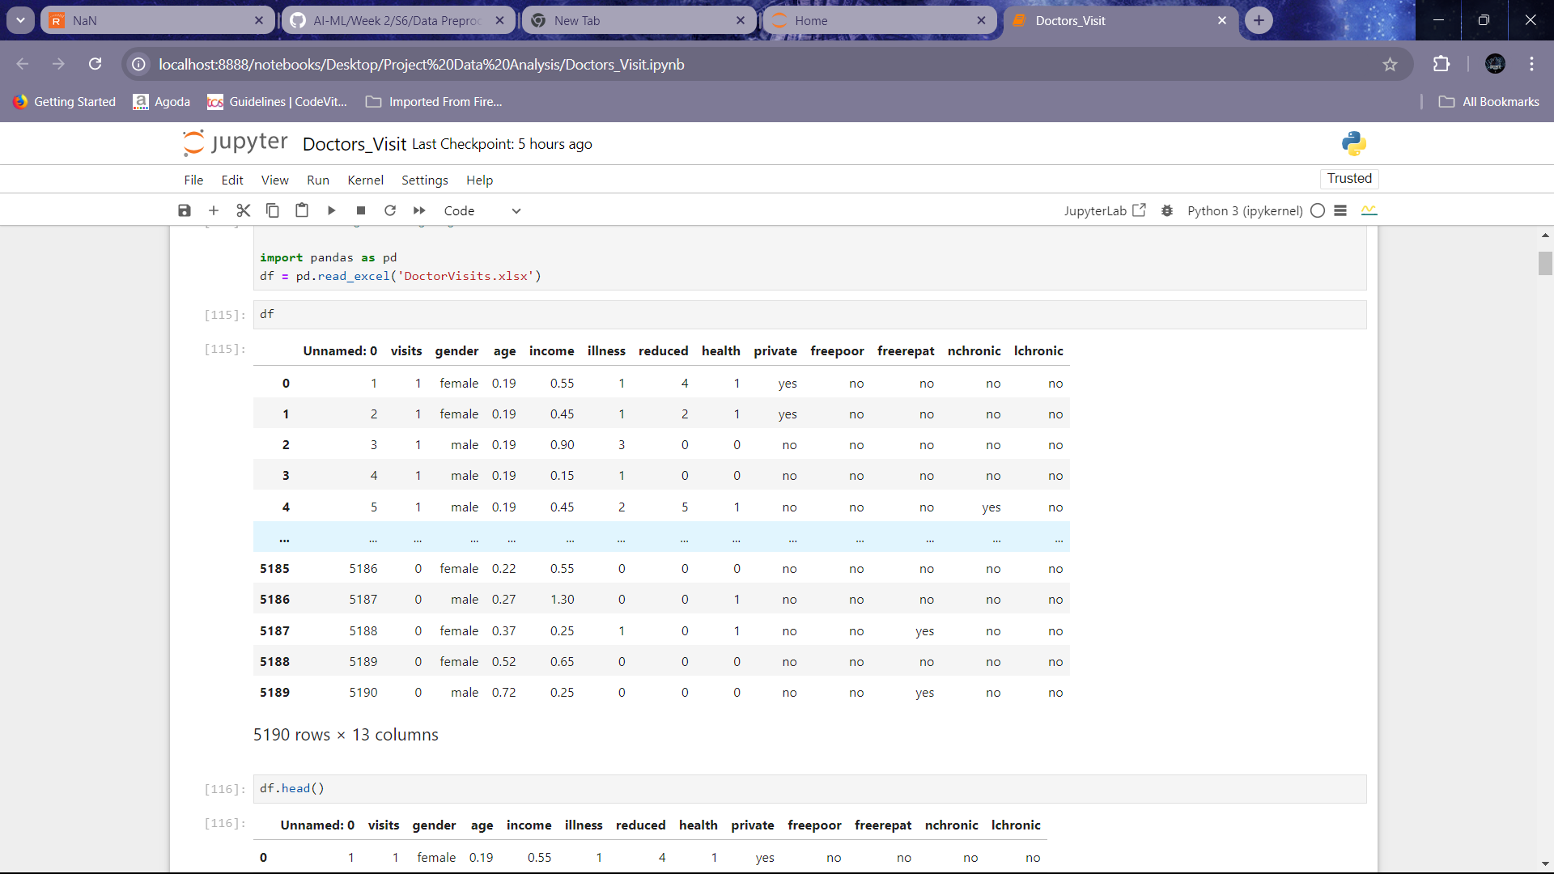
Project topic : doctor visit analysis
The given dataset contains details about the patients, their respective illness and some other important data.
We have to analyze the given data and visualize the insights and different patterns that we are able to find from the given dataset.

Slide 3
AGENDA:
The Agenda of this project is to perform Data Analysis on the given csv file which contains data about the patients visiting the doctors and their details.
In this project we are going to Analyse the given Dataset by performing actions like data wrangling where we remodel the data, data visualization where we visualize or show the results that we have derived from performing the analysis of the given Dataset.
After that we are going to use ML algorithms and implement them in our dataset. In this project I am going to use “Linear Regression” algorithm, that is used in the supervised learning ML models, to make predictions on the dataset after getting trained and we are going to see how accurate it is.

Slide 4
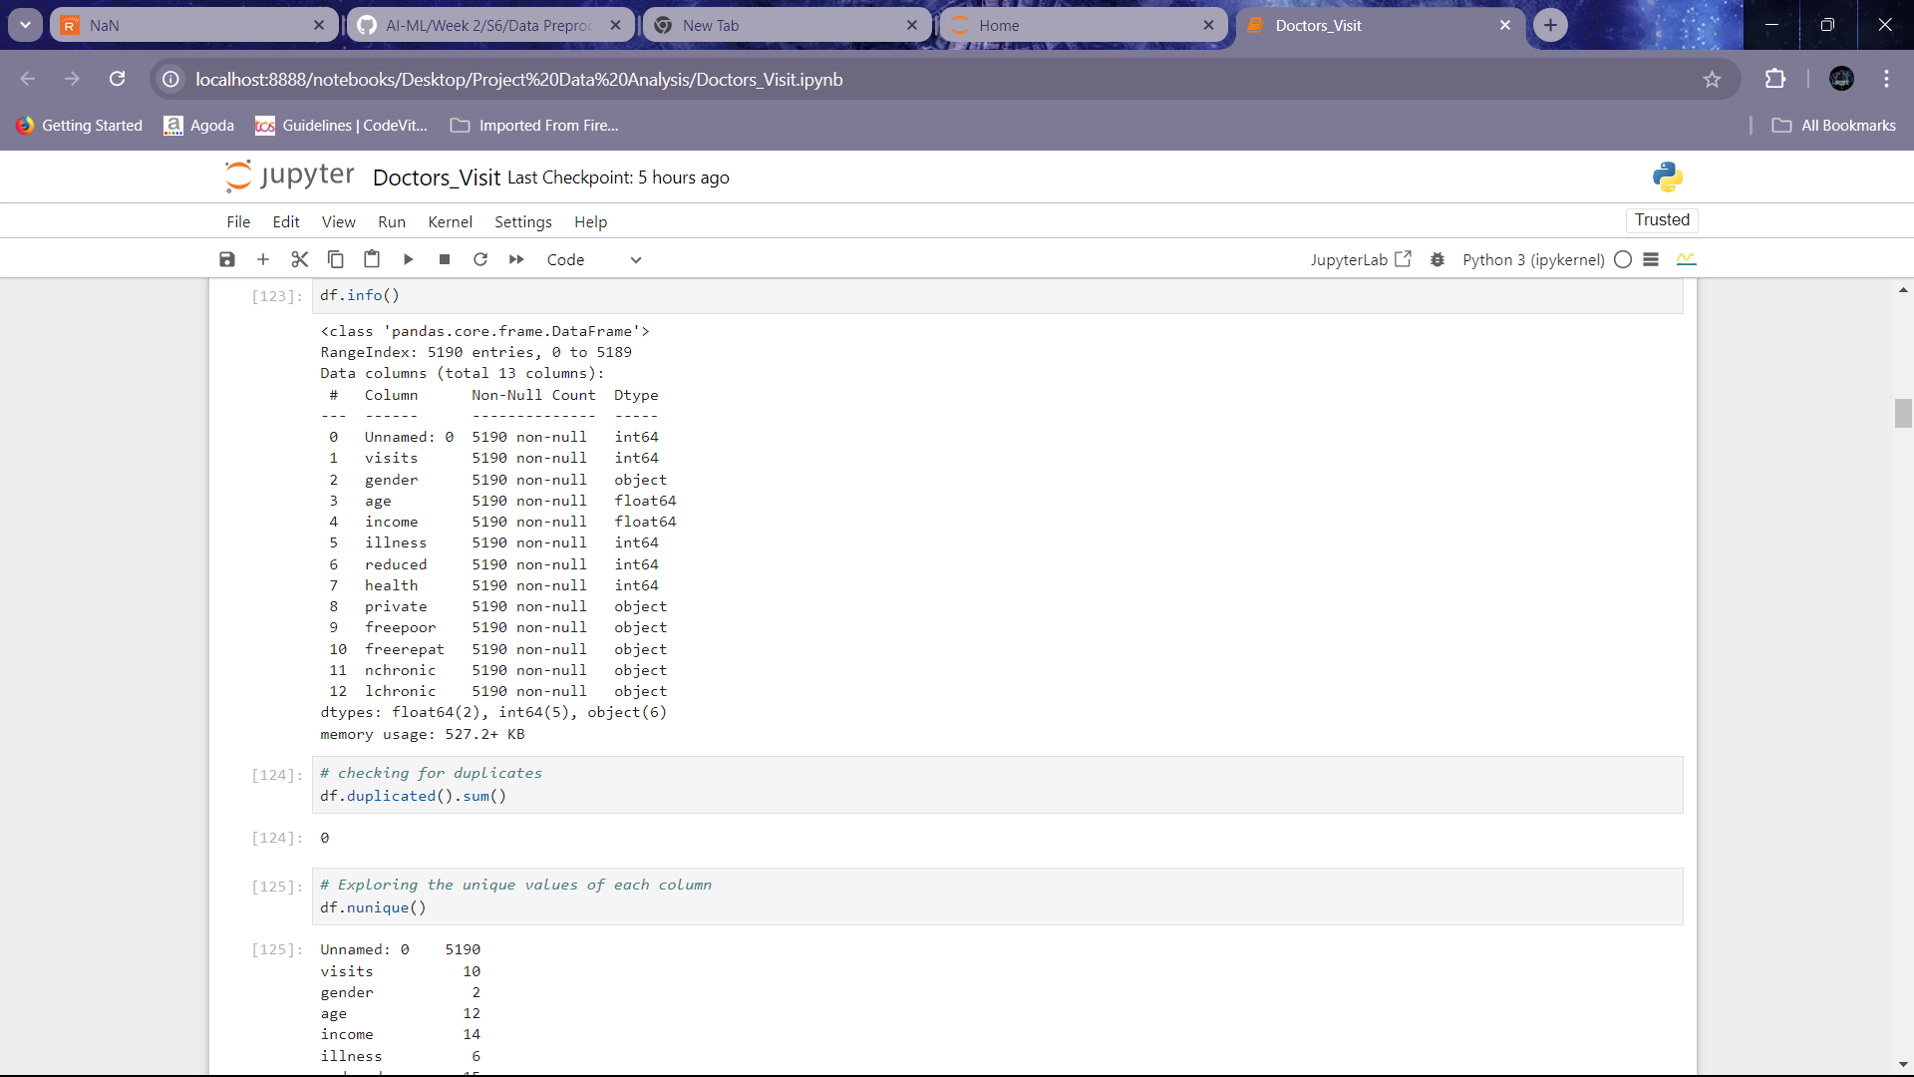
First Step:
First, we import the given dataset into the jupyter notebook and then prepare the data for cleaning. During data cleaning, we first understand the problem statement. After that we handle the missing values present in the data. Then, we try to explore the data characteristics and transform the data to prepare it for visualization. Now, we handle the outliers that are present in the data. All of the above steps are a part of the process called “Data Pre-processing”. Below are some of the images that showcase Data Pre-processing.

Slide 5
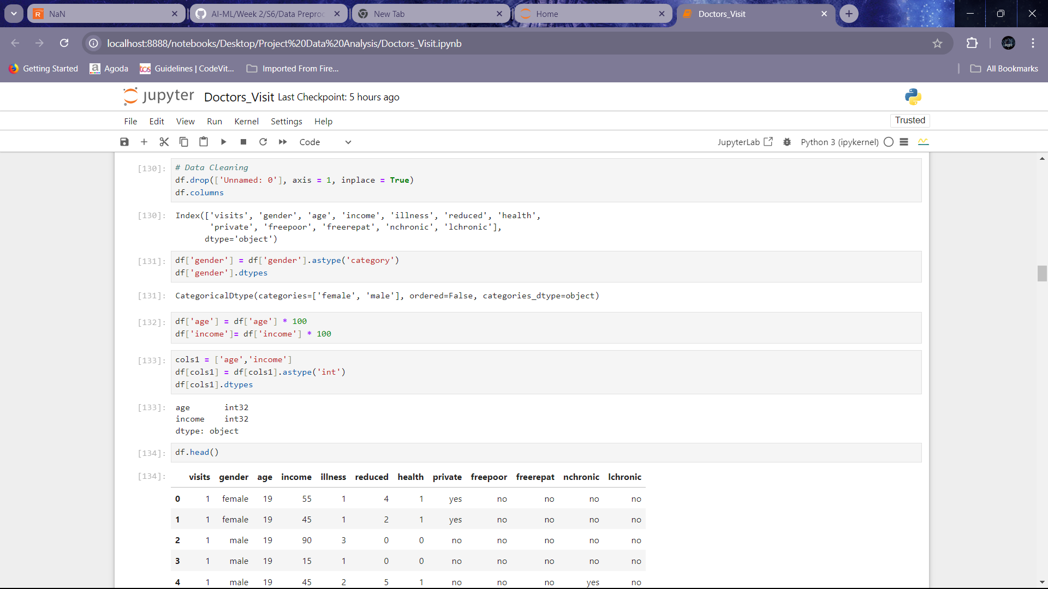
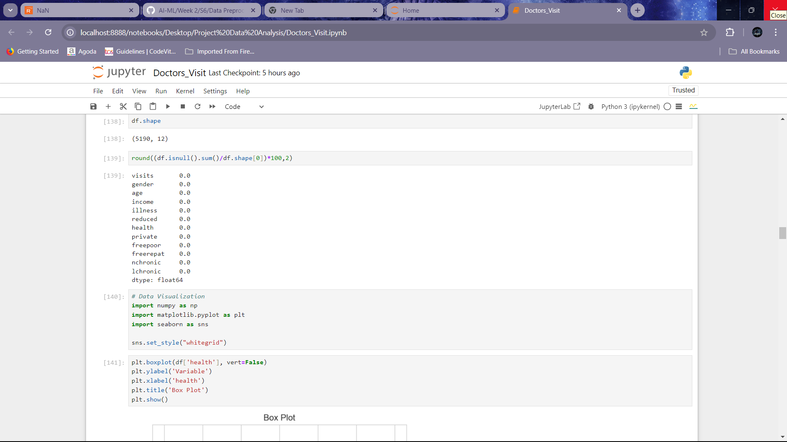
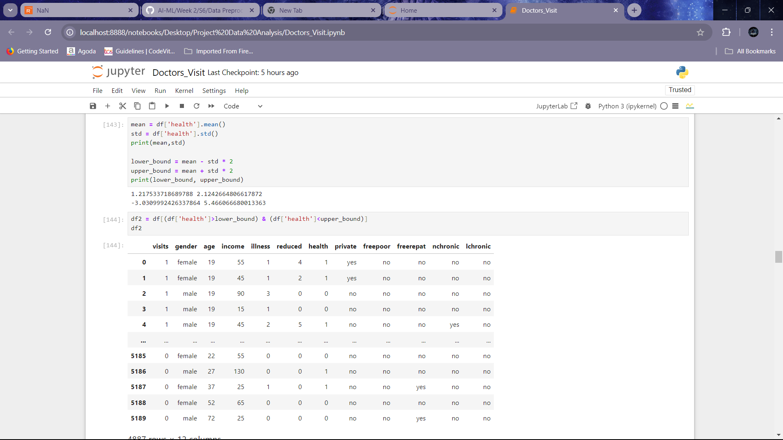

Slide 6
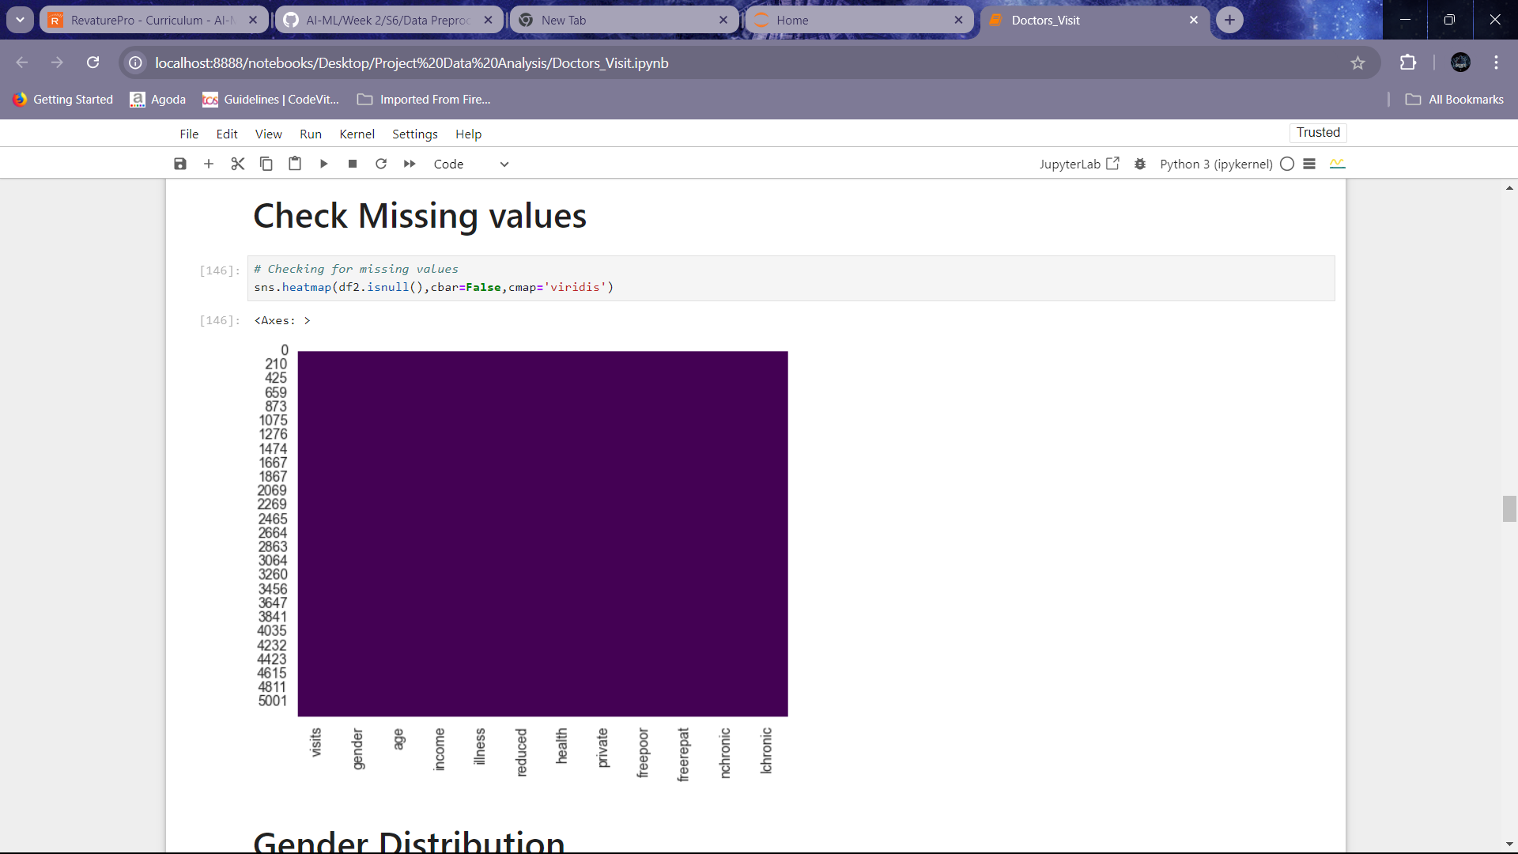
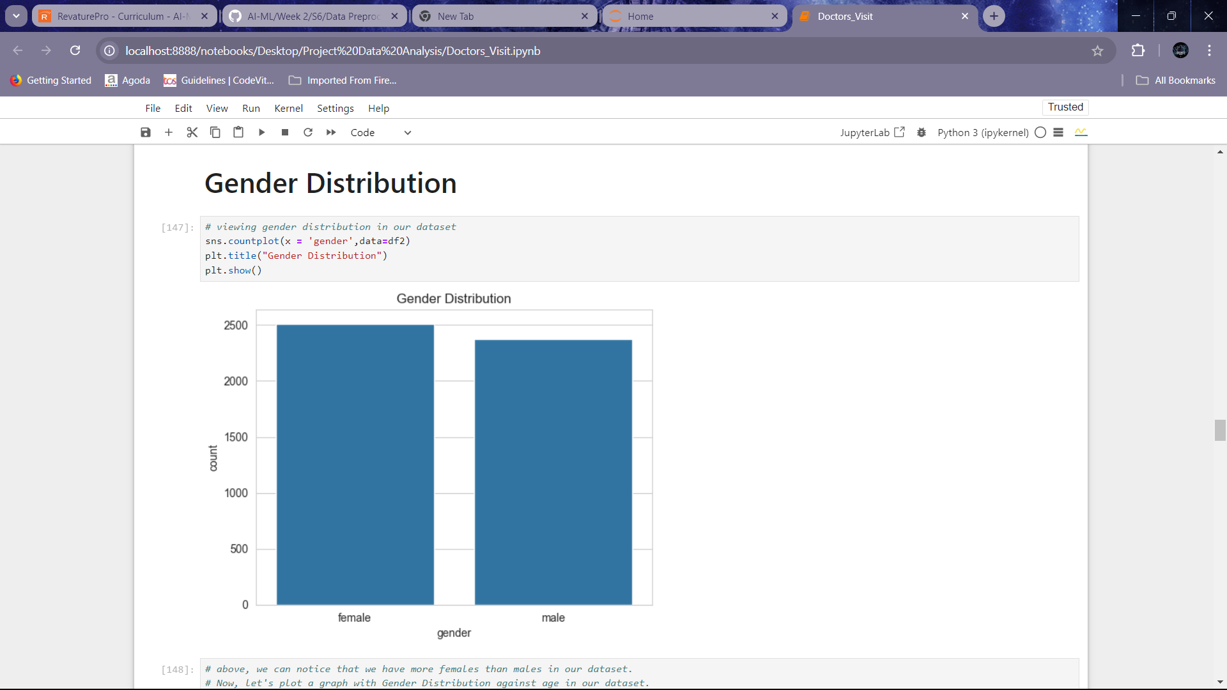
Data visualization:
After the completion of Data Pre-processing, the data is now ready for visualization. In this step, we can gain different insights that are probably present in the data. We can also find the correlation between different variables in the given dataset.

Slide 7
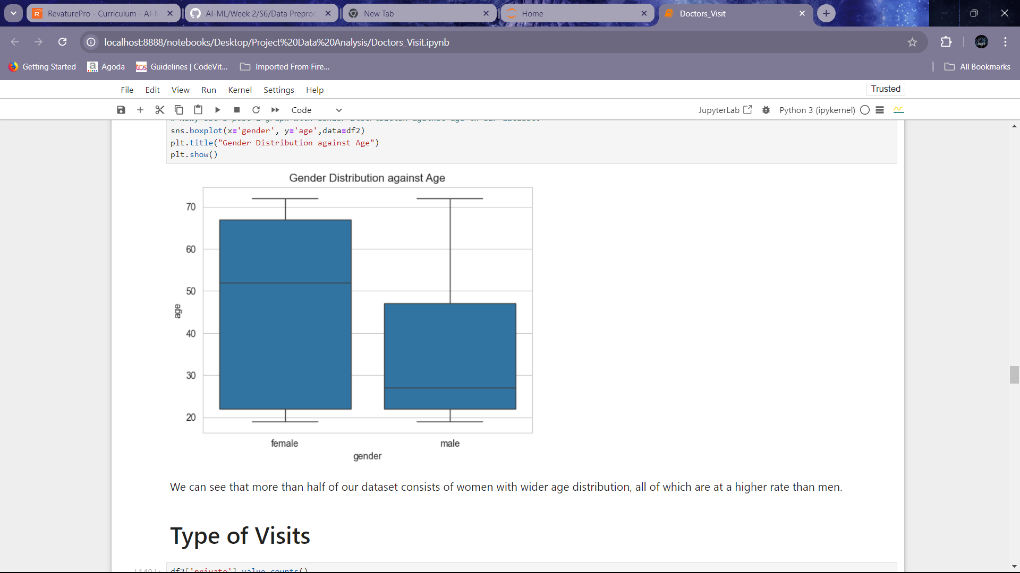
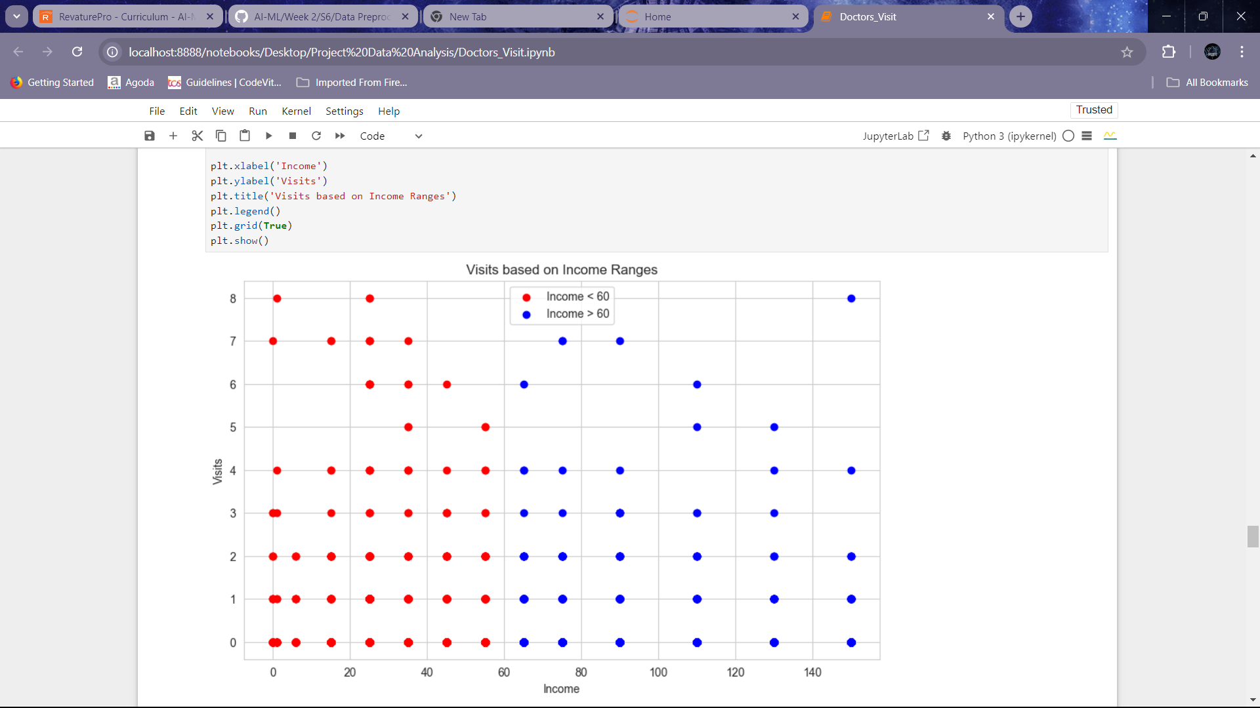
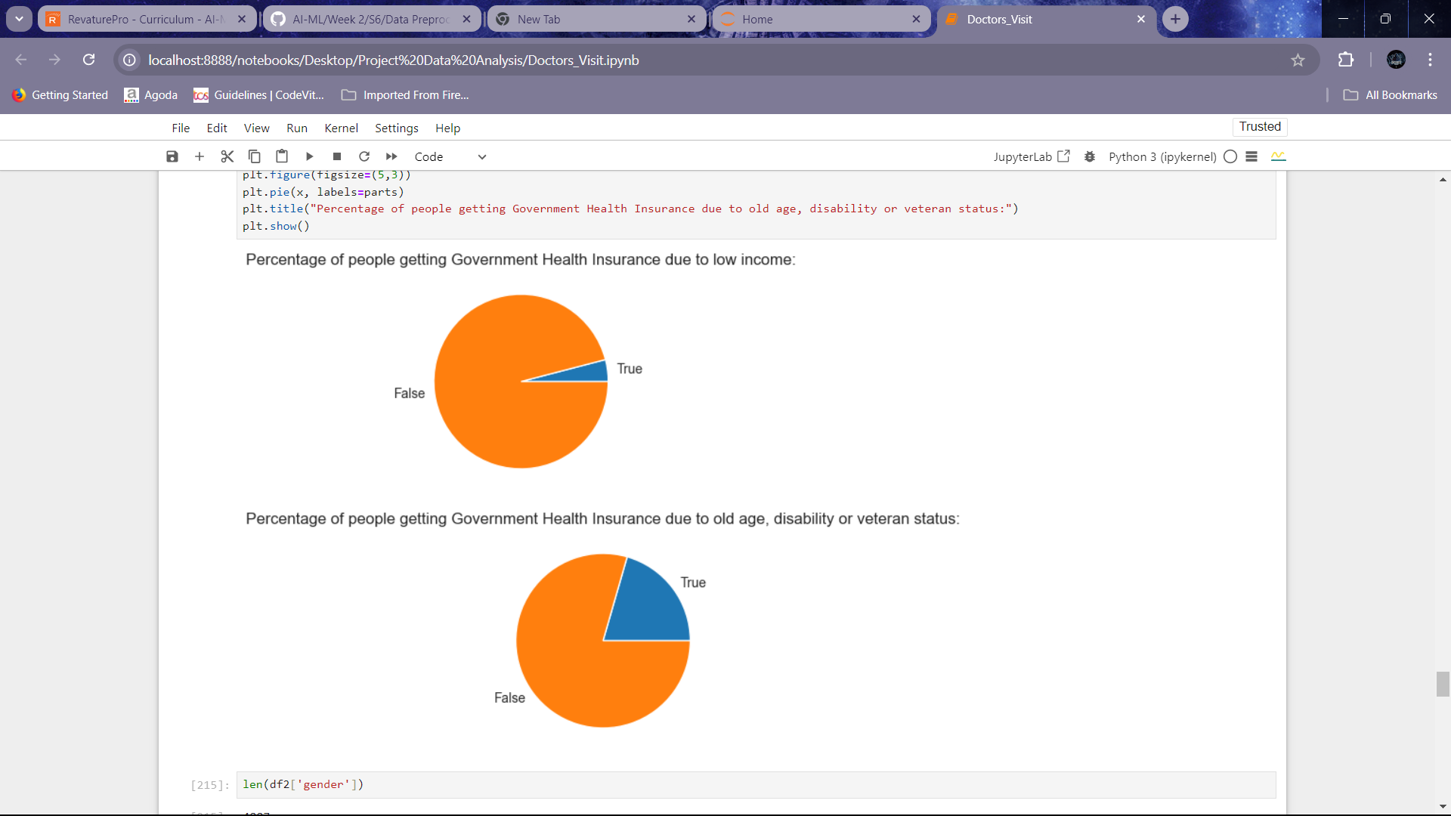

Slide 8
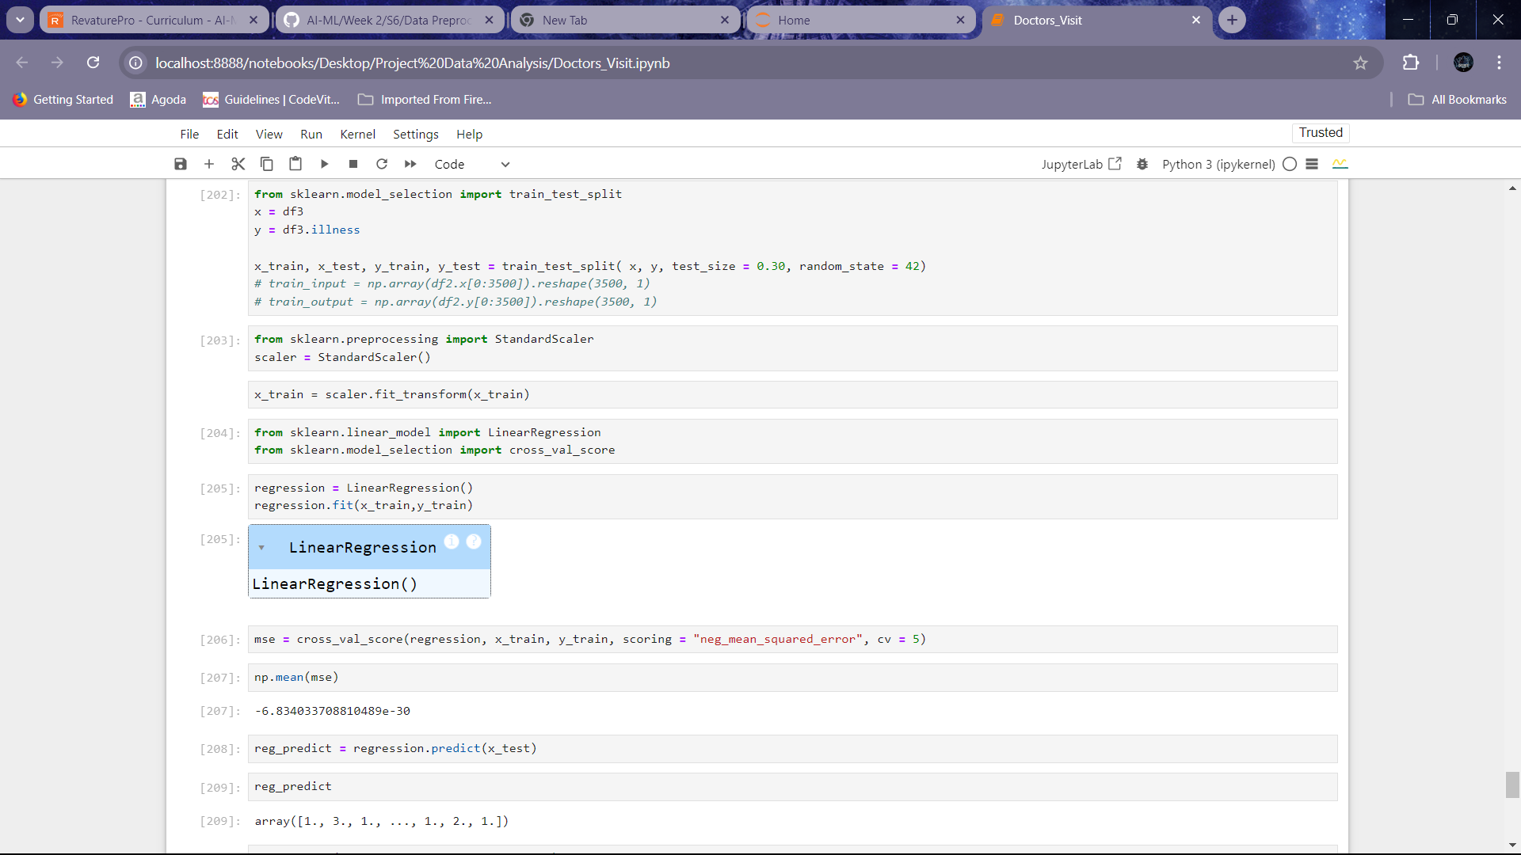
Solution and presentation:
Now, let’s implement one of the famous algorithms – “Linear Regression” into our dataset to make it capable of predicting values. Here, we are trying to predict the number of diseases a person has under the illness section.

Slide 9
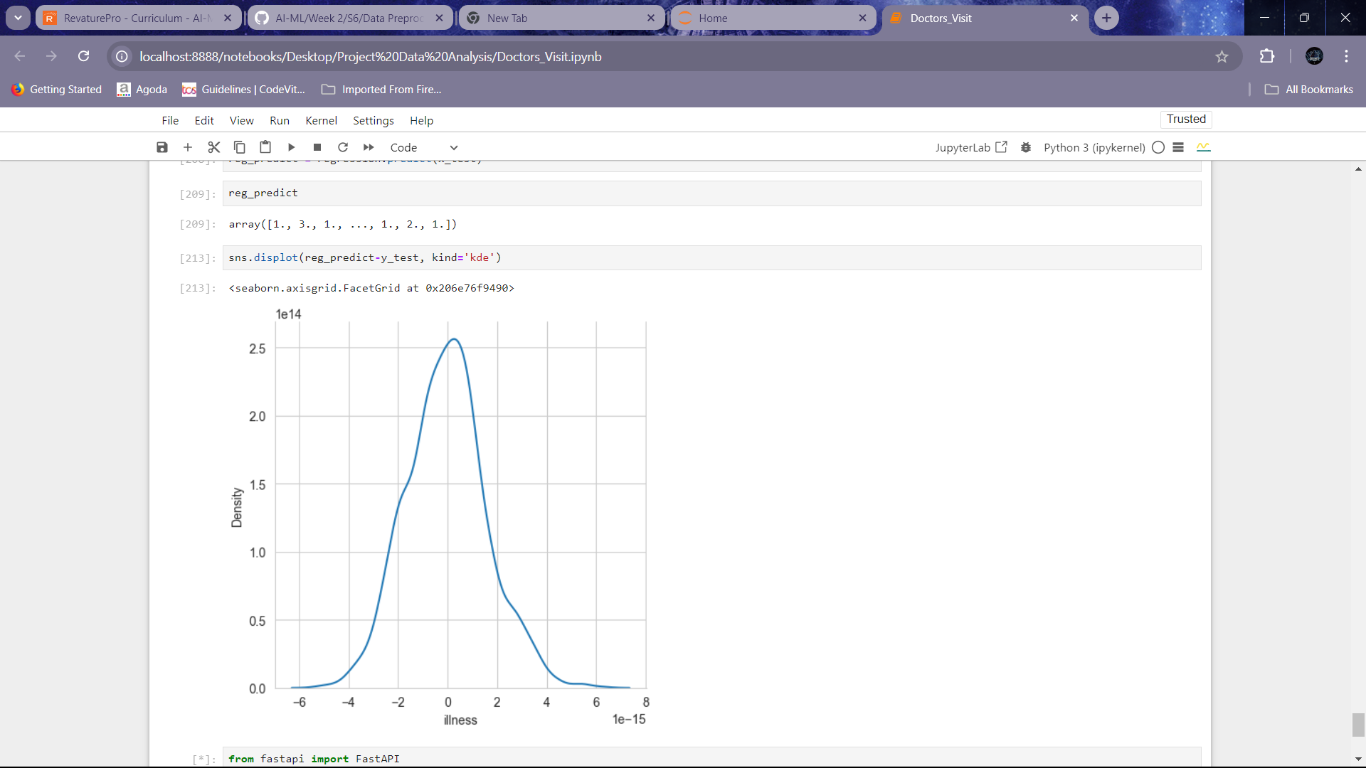

Slide 10
results:
Finally, after implementing the “Linear Regression” into our dataset, I used 70%of my data to train the dataset and 30% of it was used as test_data to test the model.
After getting trained on the given data, we test the predictions made by the model after the input is given.
We compare the results we get with the original results to find out the accuracy of our given model.
In the case of this project we compare the results through a Kernel Density Estimate(KDE) plot and by observing how the data is spread across the graph, we can calculate how accurate the model’s predictions are.

Slide 11
THANK YOU!

